Slide 1
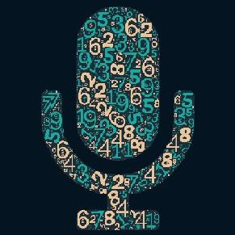
Speech to Digit Conversion using Keras and librosa
ROJI AUGUSTINE
rojiaugustine@gmail.com

Slide 2
Speech to Digit Conversion using Keras and librosa
The problem statement is to convert the given audio signal into a digit

Slide 3
Solution Description
Solution is created using librosa (a python package for music and audio analysis) and Keras (open-source software library that provides a Python interface for artificial neural networks)
2000 labeled audio samples are given which is having recording of digits 0 – 9. There are 200 samples for each digit from different speakers.
The audio samples are converted into Mel-frequency cepstral coefficients (MFCCs) using librosa, before fed into the neural network. MFCC is preferred for problems dealing with human speech
The solution achieved categorical_accuracy of 0.9813 on train data and 0.9800 for validation data
A web app is developed for real-time inference for audio from user
Batch inference can be done using the code from the Jupyer notebook

Slide 4
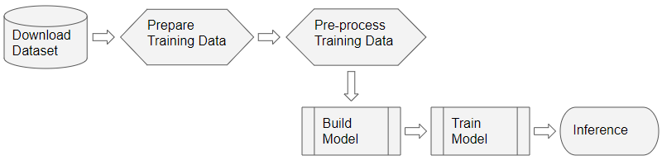
Solution Description contd

Slide 5
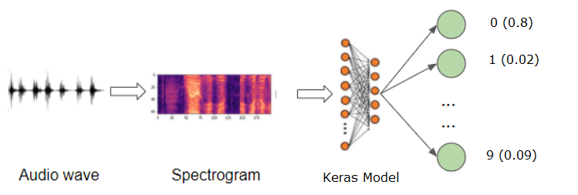
Solution Description contd

Slide 6
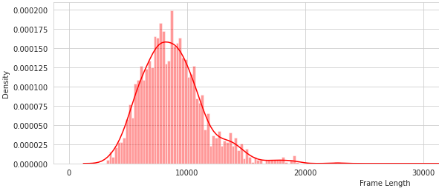
Data Exploration
Histogram on frame length

Slide 7
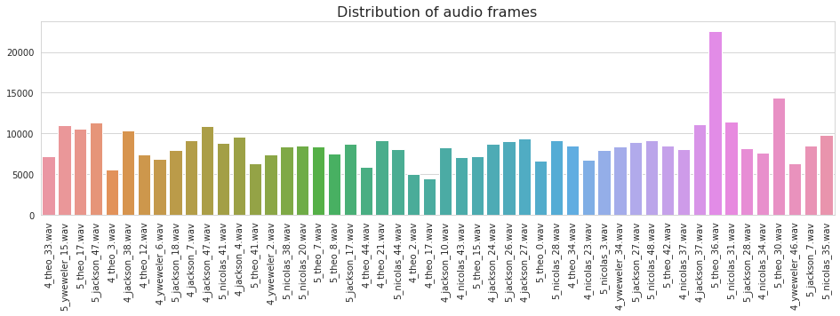
Data Exploration
Frame length Vs Filename (sample)

Slide 8
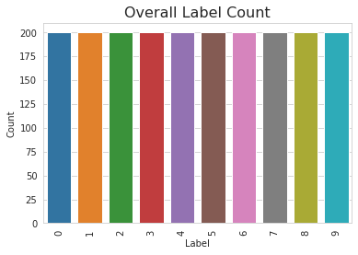
Data Exploration
Label count from audio data

Slide 9
Keras model
Optimiser : Adam
Learning rate : 0.01
Activation : Relu, softmax
Metrics : categorical_accuracy
Dropout : 0.2
Epochs : 300

Slide 10
Development tools/SDKs/APIs
Python
Jupyter notebook for development
Keras, Librosa, seaborn
pyAudio, streamlit, PIL

Slide 11
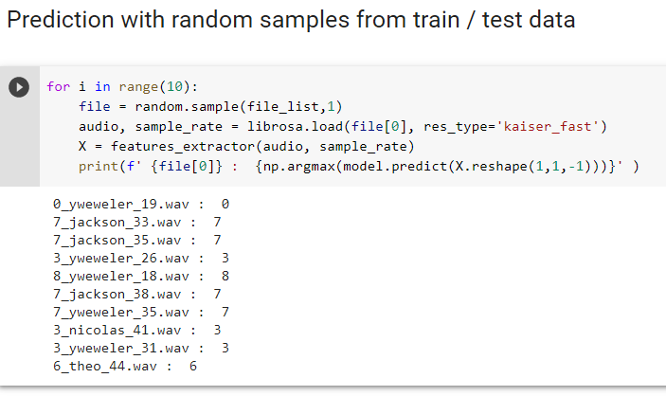
Code, Test cases and Test results
Jupyter notebook and web app is attached with zip file
loss: 0.0803 - categorical_accuracy: 0.9813 - val_loss: 0.1207 - val_categorical_accuracy: 0.9800

Slide 12
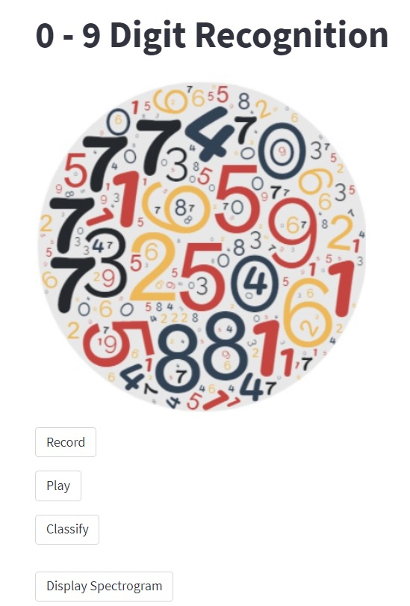
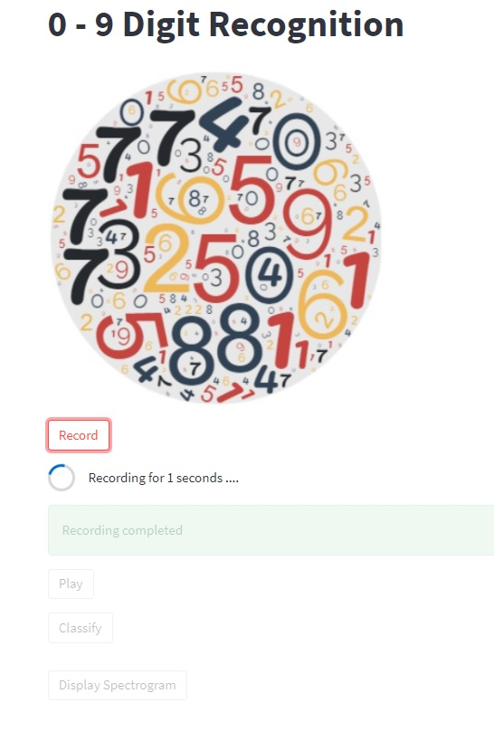
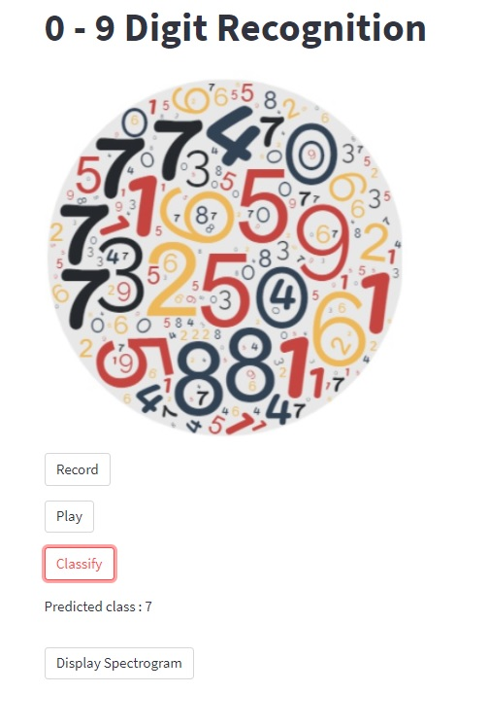
Real time inference web app

Slide 13
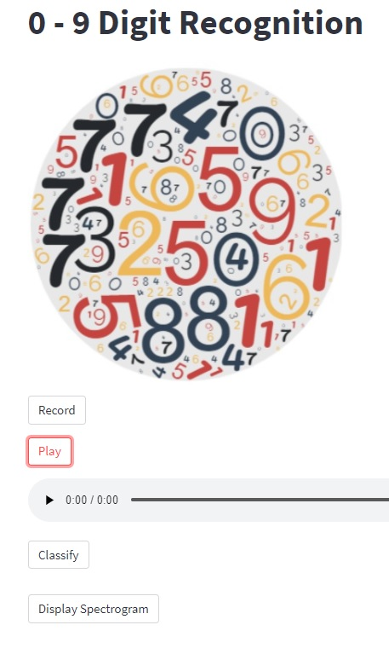
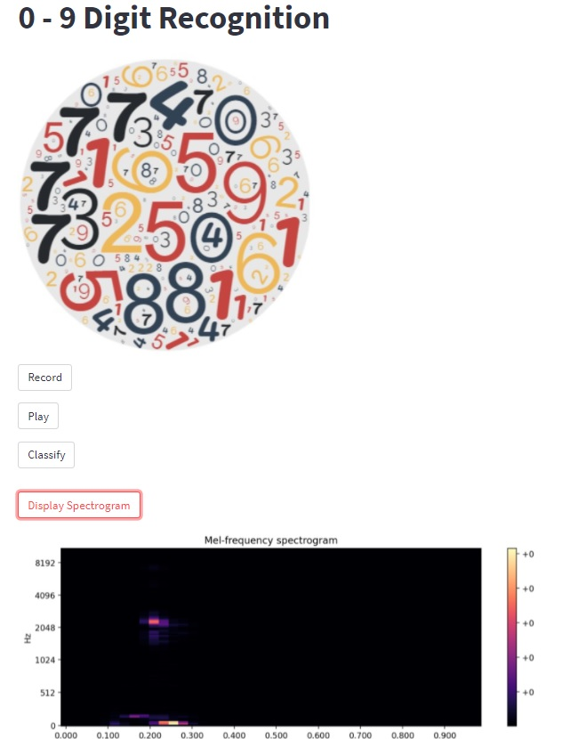
Real time inference web app contd

Slide 14
Further improvements
Spectrogram Augmentation : Frequency mask, Time mask
Raw Audio Augmentation : Time Shift, Pitch Shift Time Stretch, Add Noise
Include cross validation
Try convolutional networks and other pertained networks like ResNet, EfficientNet etc
Hyper parameter tuning with KerasTuner
Real-time inference is not efficient because of audio conversion issues between pyaudio and librosa

Slide 15
References
https://keras.io/
https://librosa.org/
https://streamlit.io/

Slide 16
Thank You

